Slide 1
Roll NO: 20P-0147 Name: Shoaib Akhtar Section : B Presentation : Two

Slide 2
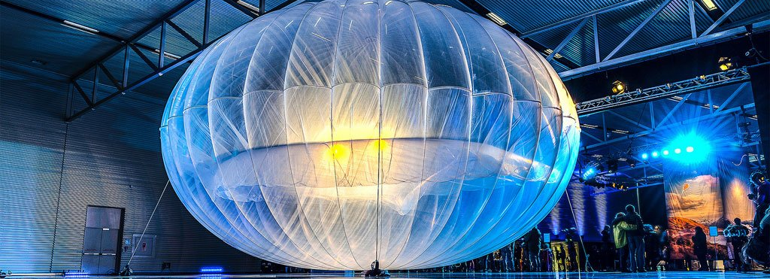
Google Balloons
.

Slide 3
INTRODUCTION
What happens when you don’t get the network signals from tower and get it from flying balloons
Oh yes! Google had made it possible
According to a report there are 33% peoples in this world, whom don’t have internet facilities

Slide 4
If we talk about india, from 121 crores population there are only 50 crore peoples have internet facilities.
And if we talk about rural areas, remote areas, frozen areas their is no internet facilities.
But now the can access internet through google balloons.

Slide 5
How it works
Google will fly big balloons in the sky and with the help of these balloons the areas like rural. and remote will access internet.
And these balloons are filled up with heleium gas.
And these balloons can fly 18 to 25 km in the sky.

Slide 6
In these balloons basket is replaced with chargeable battery, solar cell, and receiver antenna
Receiver antenna will send and receive signals
And these balloons wiLL provide the 4G LTE network speed which is really huge speed specially at rural areas
These balloons will fly in stratosphere layer

Slide 7
.
Why stratosphere layer

Slide 8
ADVANTAGES OF GOOGLE BALLOONS
Easy to Use
Availability of information
Increased internet usage

Slide 9
Disadvantages of Google balloons
Cost
Maintenance

Slide 10
CONCLUSION
Project loon is an ambitious project and the world will highly benefit from it
Project loon, an initiative to help fill in those internet gaps through the use of networked balloons
The goal is to provide broadband like internet for the two-third of the world that doesn’t have access to a reliable internet connection by balloon
It is still an experimental phase

Slide 11
REFERENCES
Levy, steven (14-june 2013) “ How google will Use High-Flying Balloons to Deliver internet to the Hinterlands” , Wired Retrieved 15-june 2013
“Google to beam internet From balloons”. Agence France Presse Google 15-june 2013 retrieved 16-june 2013
“Google launches project loon”. The New Zealand Herald 15-june 2013. Retrieved 15-june 2013
Lardinois , Frederic(14-june 2013) . “ Google X Announces Project Loon: Balloon-powered internet for rural, remote and undeserved areas. Tech Crunch . Retrieved 15-june 2013
Mack eric (14-june 2013) . Meet Google’s Project Loon: “Balloon powered” net access “ CNET Retrieved 15 15-june 2013

Slide 12
https://www.youtube.com/watch?v=ub9FSSMuzbM&t=116s

Slide 13
THANK YOU SO MUCH!

